Slide 1


CodeCrafers
- Online Code Editor

Slide 2


Introduction
Code-Crafters is an online code editor project is a cutting-edge web-based development tool designed to provide a seamless and collaborative coding experience for developers, students, and
professionals.
This platform aims to simplify coding tasks by offering a feature-rich, accessible, and user-friendly environment where
users can write, compile, debug, and share code effortlessly.

Slide 3
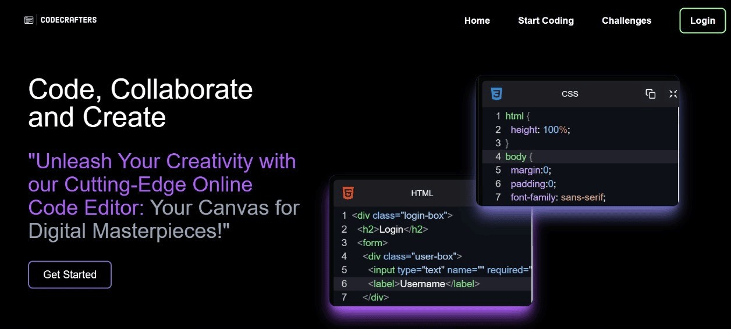
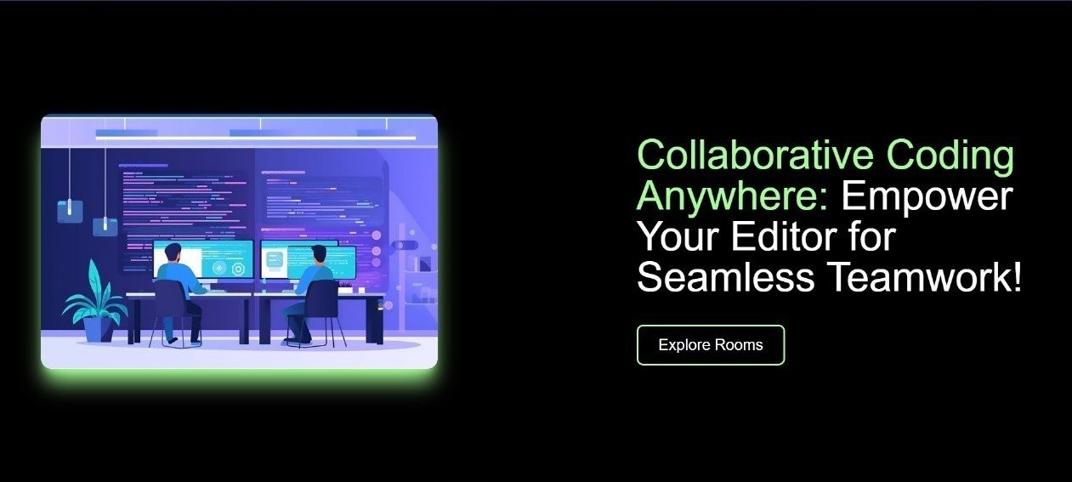
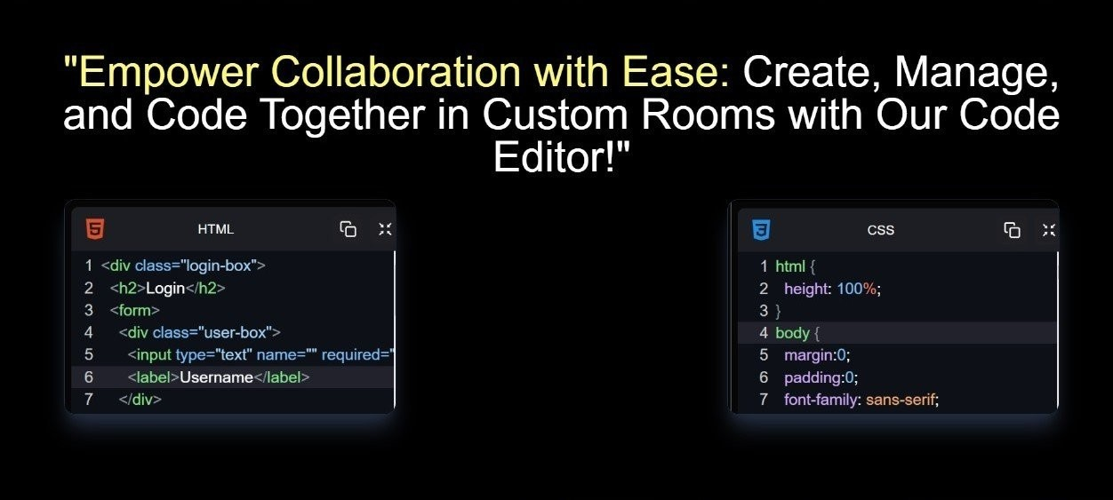
Implementation

Slide 4

KEY FEATURES :
Code Editing: users can write, edit, and format code in various programming
Multi-Language Support: the editor supports a wide range of programming languages.
Live Preview: instantly visualise the output of your code
with a live preview feature,
Collaboration Tools: real-time collaboration features allow multiple users to code together.
Auto-Save: automatically saving work to prevent data loss.

Slide 5

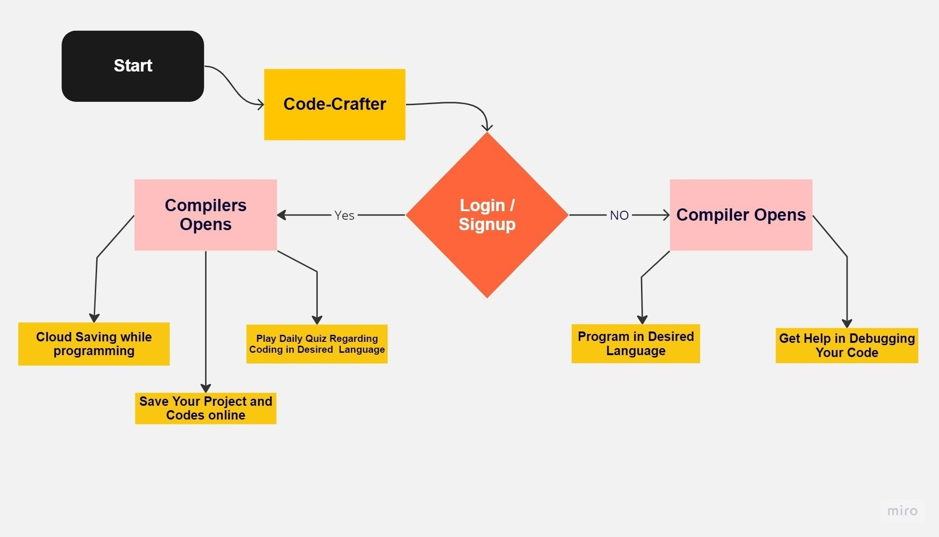


FLOWCHART

Slide 6

Technology Stack :
FRONTEND:
HTML5 CSS3
JavaScript (React Js.)
BACKEND:
Node Js Express Js
DATABASE:
MongoDB
REAL-TIME FEARURE:
WebSocket

Slide 7

Implementation Plan
To implement a WebSocket-based online code editor, we will need to develop a custom editor that supports real-time collaboration. We will also need to integrate WebSocket technology into the editor and create a server that can handle
multiple connections.

Slide 8
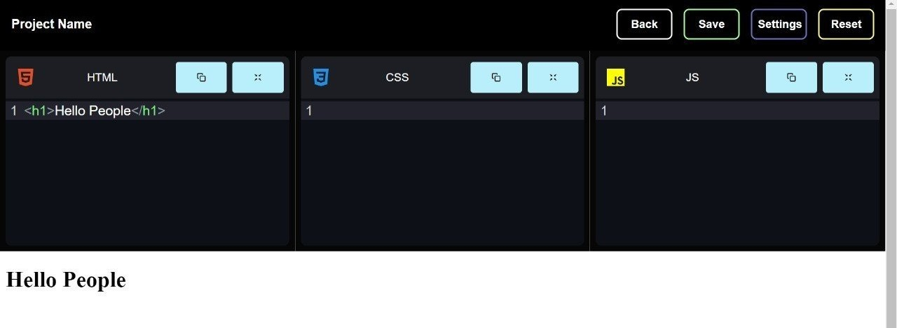
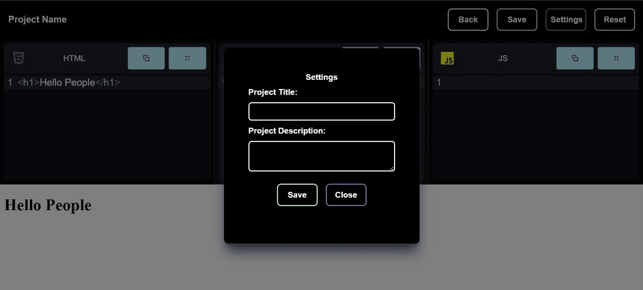
IMPLEMENTATION :
Code Studio :

Slide 9
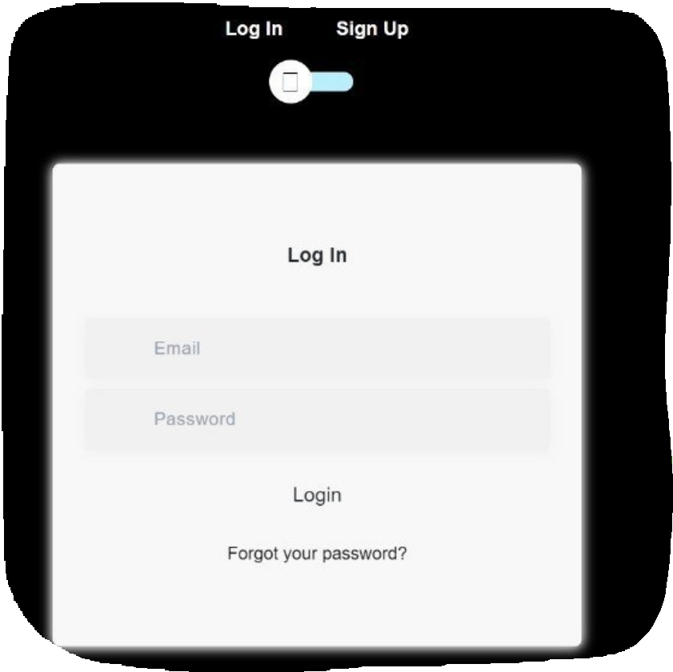
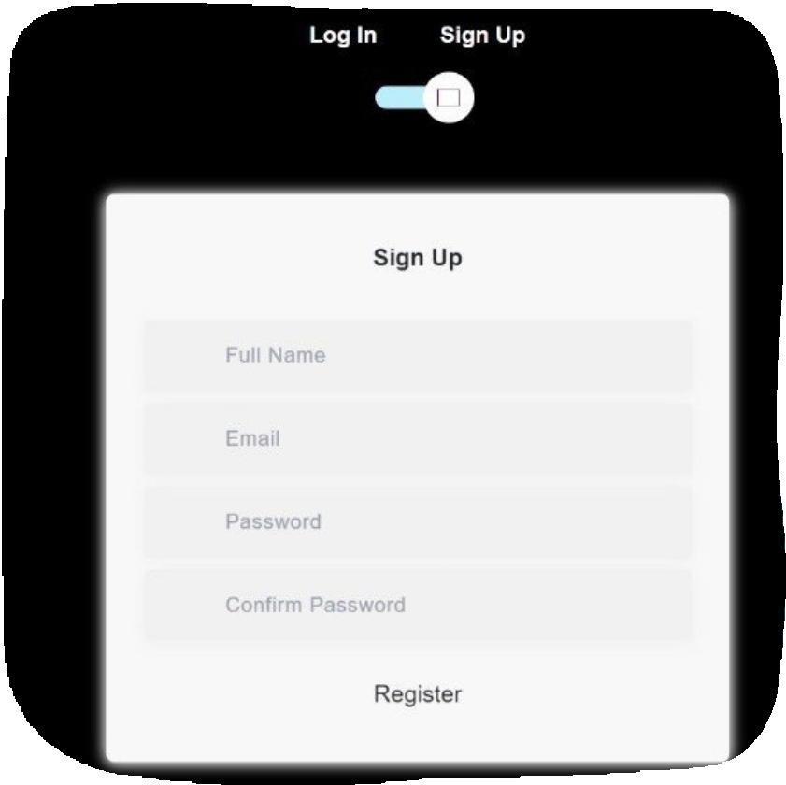
Authentication

Slide 10
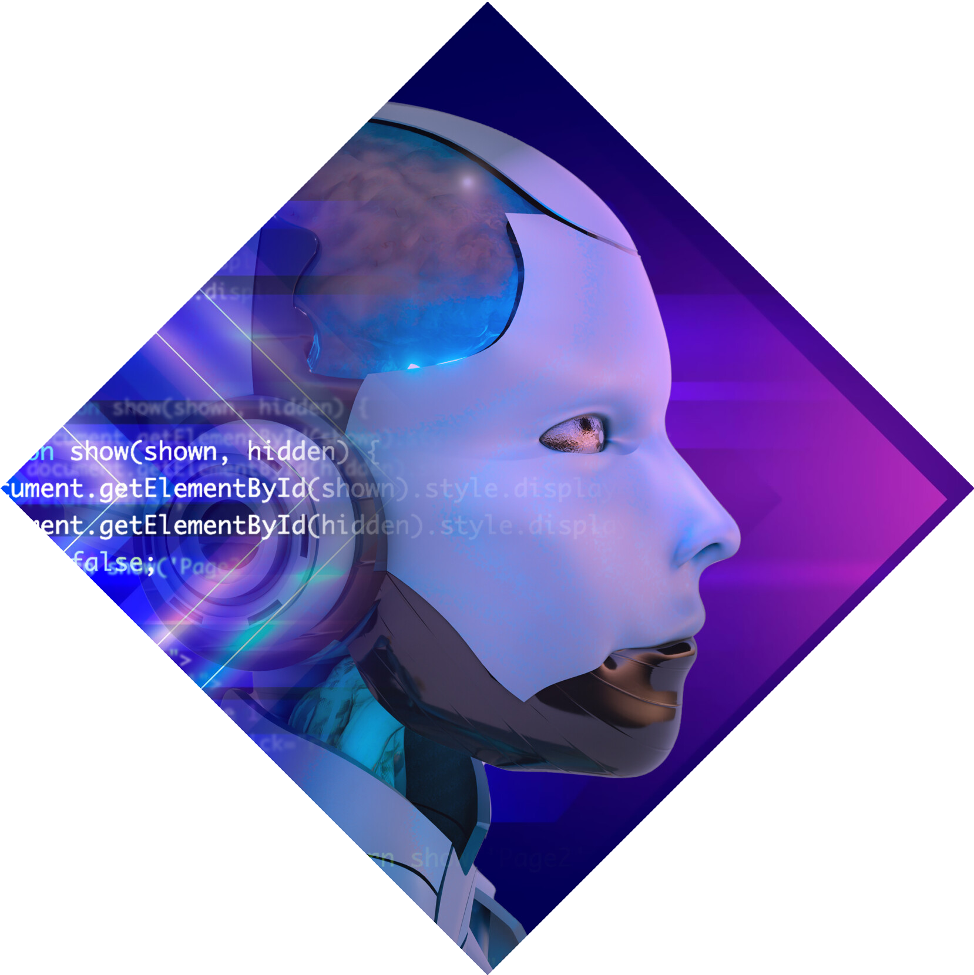
FUTURE ENHANCEMENTS:
AI Code Assistance: Implement ai-driven code suggestions and auto-completion.
Mobile App: Develop a mobile version for coding on the go.
Integrated Documentation: Provide instant access to documentation for various languages and libraries

Slide 11
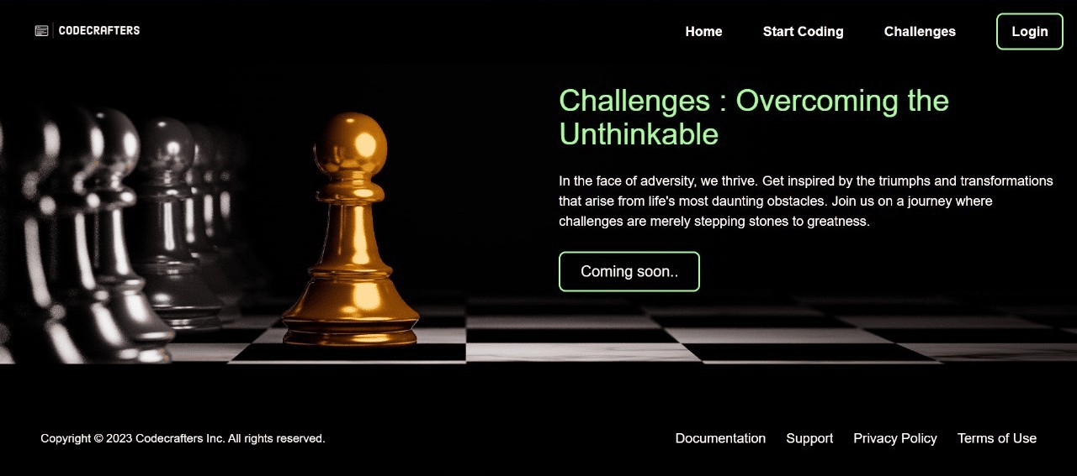
Future Challenges Fearure:

Slide 12
Conclusion
This online code editor has the potential to revolutionize online collaboration by allowing developers to work together in real-time. By increasing productivity, improving code quality, and enhancing collaboration, a WebSocket-based online code editor can help development teams achieve their goals more efﬁciently.

Slide 13
Thanks!
Kirtan Nahar Nimit Garg Akshay Mann Hardik Jain

